Slide 1
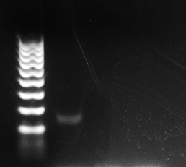
Positive control
Negative control
PD07-fibroblast

